Slide 1


Slide 2
NASA API
Dhun Sheth, Tim Pulfer, Jacob Rosen

Slide 3
The APIs in Our Package
01
Mars Rover Photos
02
Near Earth Objects
03
Earth Polychromatic Imaging Camera
Retrieve images from NASA's rovers on Mars.
Search near Earth objects based by date.
Retrieve images from DSCOVR's Earth Imaging Camera.

Slide 4
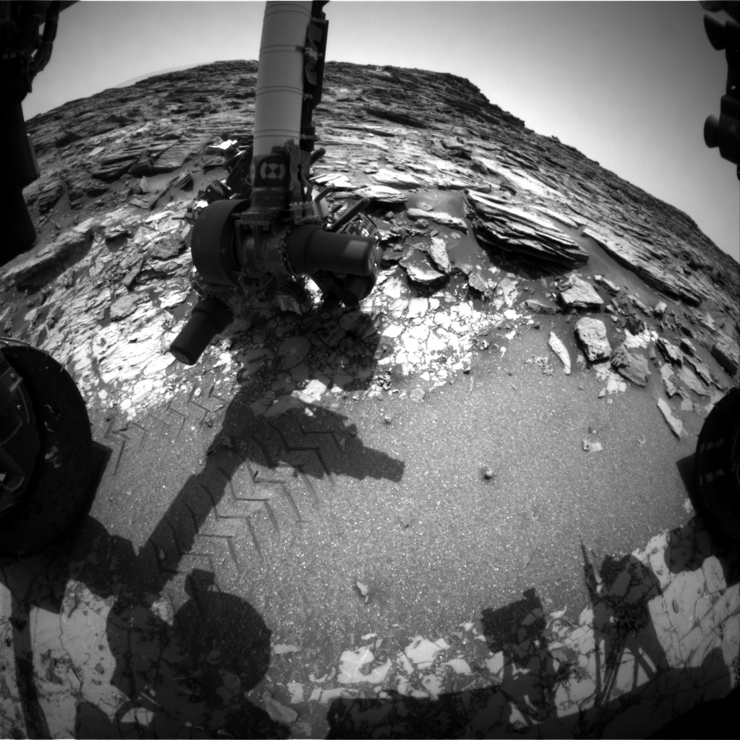
Mars Rover Photos
This wrapper function will allow the user to request a photo from one of the three NASA rovers on Mars. The parameters for the function will be…
Rover name (Curiosity, Opportunity, Spirit)
Camera angle.
Data of the photo.
The function will return a link to the .JPEG image that was requested.
Example : get_mars_rover_image_url("curiosity", "fhaz", "2023-01-01")

Slide 5
Near Earth Objects (NEO)
This function will let the user search for NEO’s based on start/end date and give asteroid specific information.
Function Parameters:
start/end date (Max difference between start/end date must be 7 days)
Example query results: https://api.nasa.gov/neo/rest/v1/feed?start_date=2015-09-07&end_date=2015-09-08&api_key=DEMO_KEY
Functions:
- get_response()
- check_date()
- get_plot()
- get_neo()

Slide 6
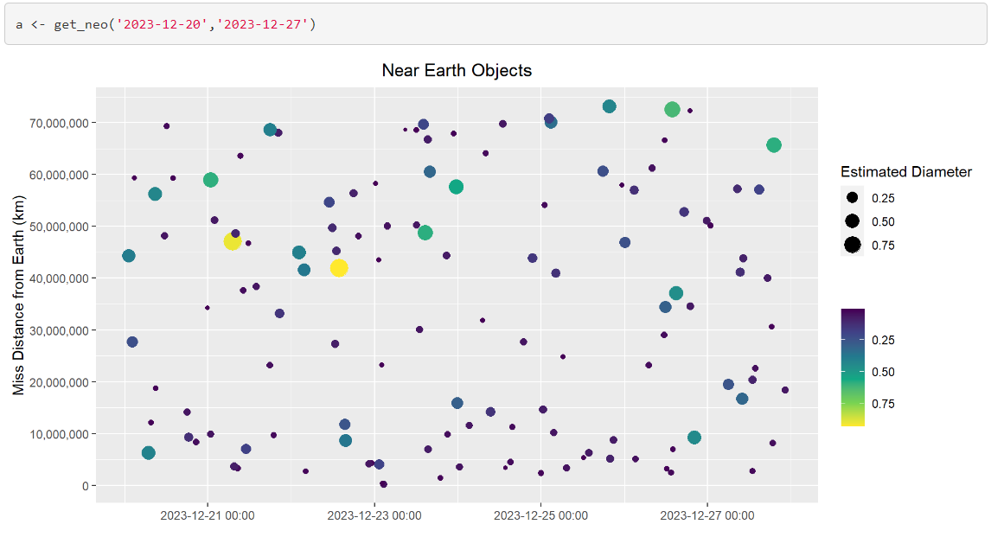

Slide 7
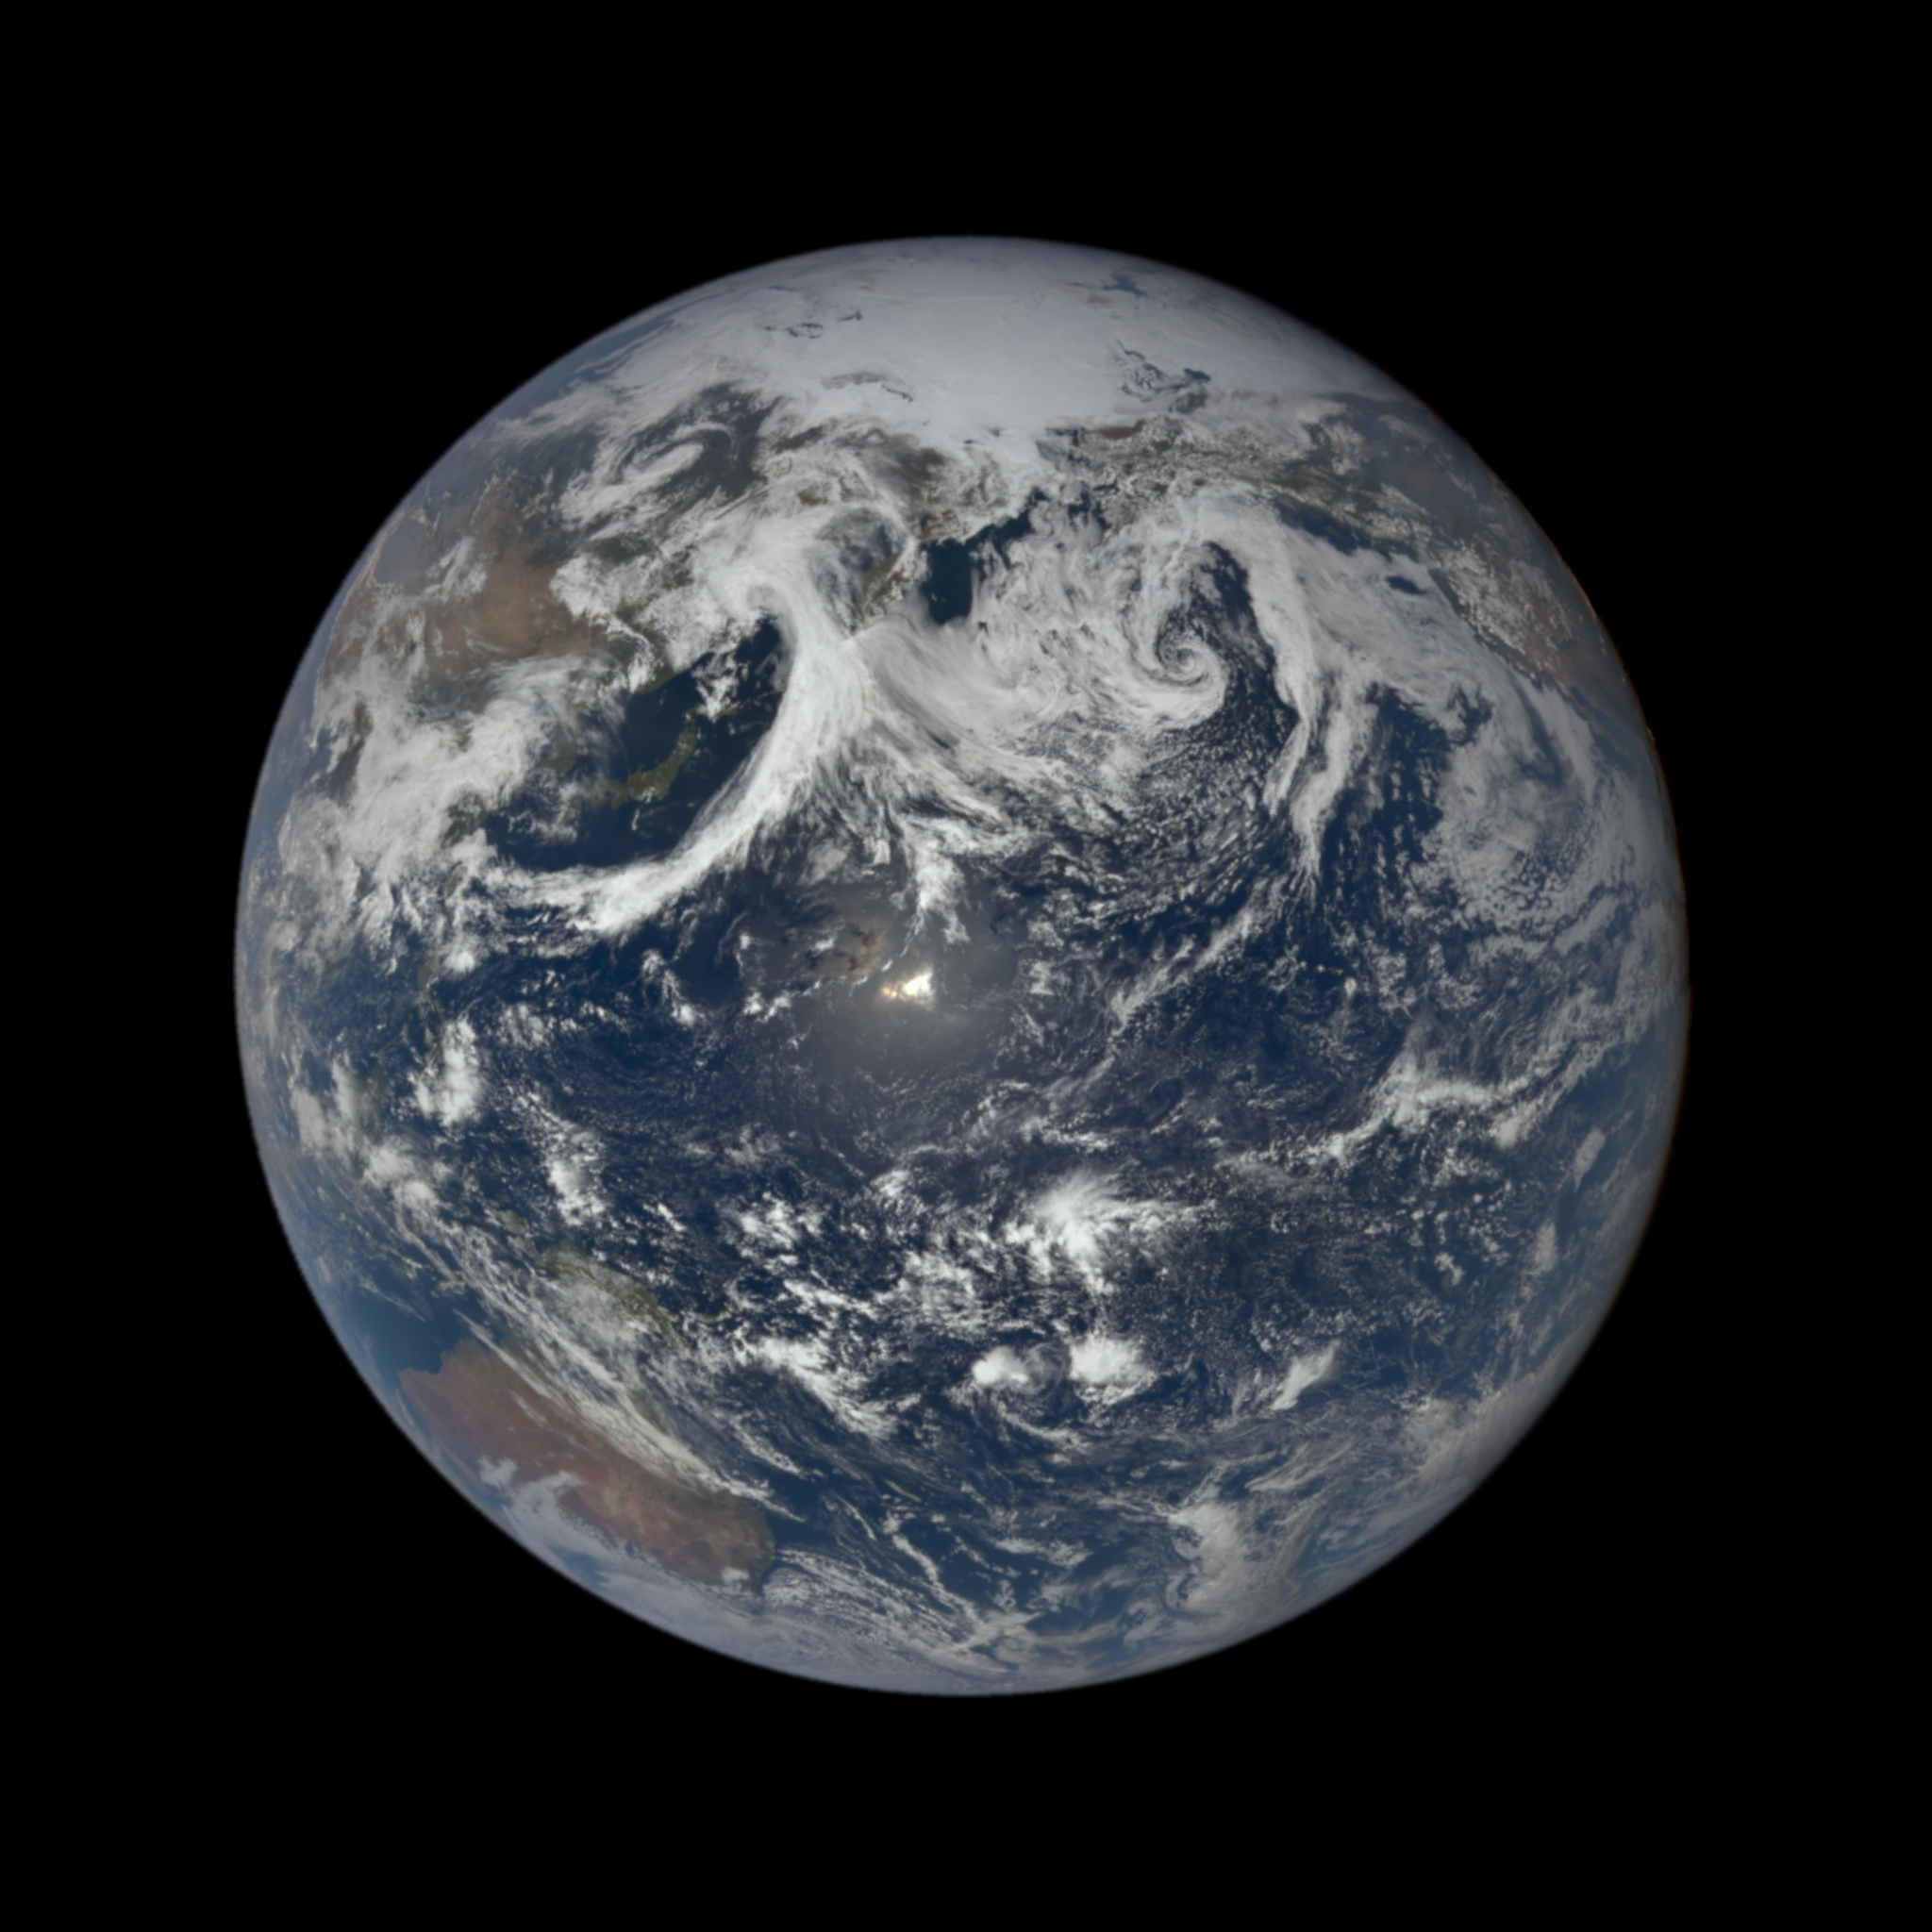
EPIC
This wrapper function will allow the user to request images and metadata from the daily imagery collected by DSCOVR's Earth Polychromatic Imaging Camera (EPIC) instrument. The parameters:
Date (optional)
Natural/enhanced/aerosol/cloud image type
https://epic.gsfc.nasa.gov/about/api

Slide 8
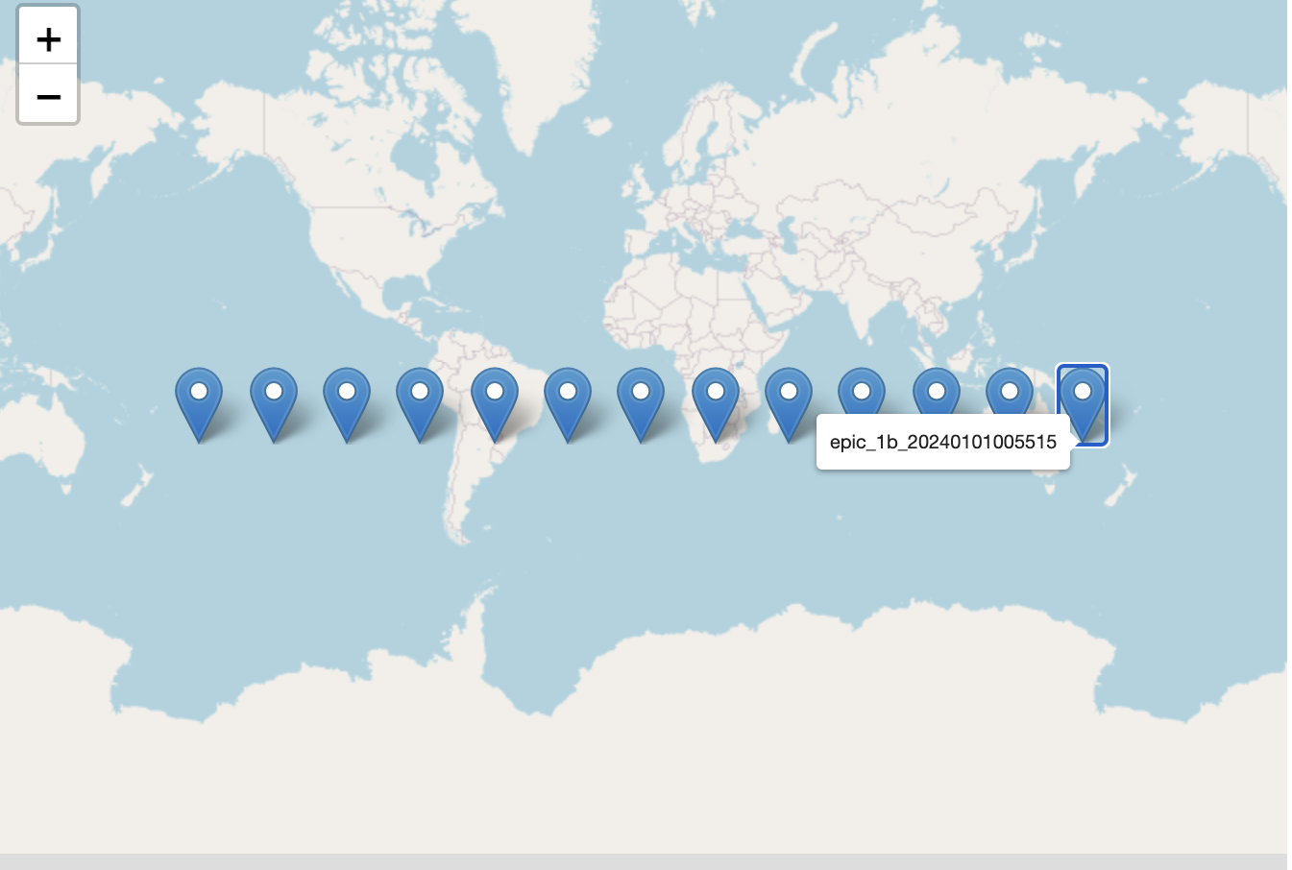
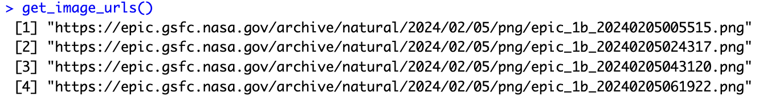
EPIC
Use the get_image_urls(type, date) function to get a list of image urls like the following:
Each url can be used to access an image taken from that day.
To get an idea of the image scope we can plot the centroid using the plot_centroids(type, date) function. This will help determine what part of earth each image captures.

Slide 9
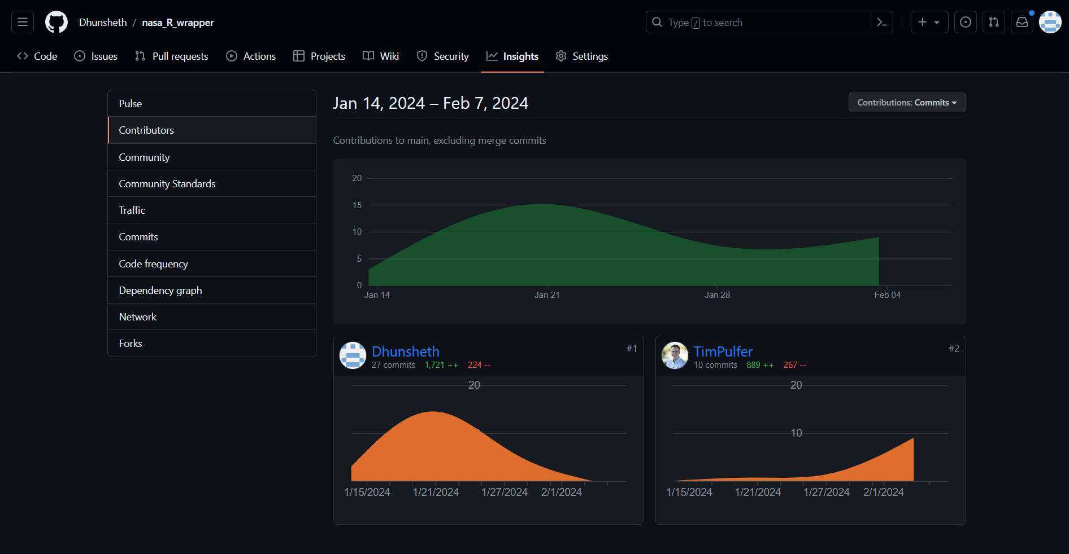
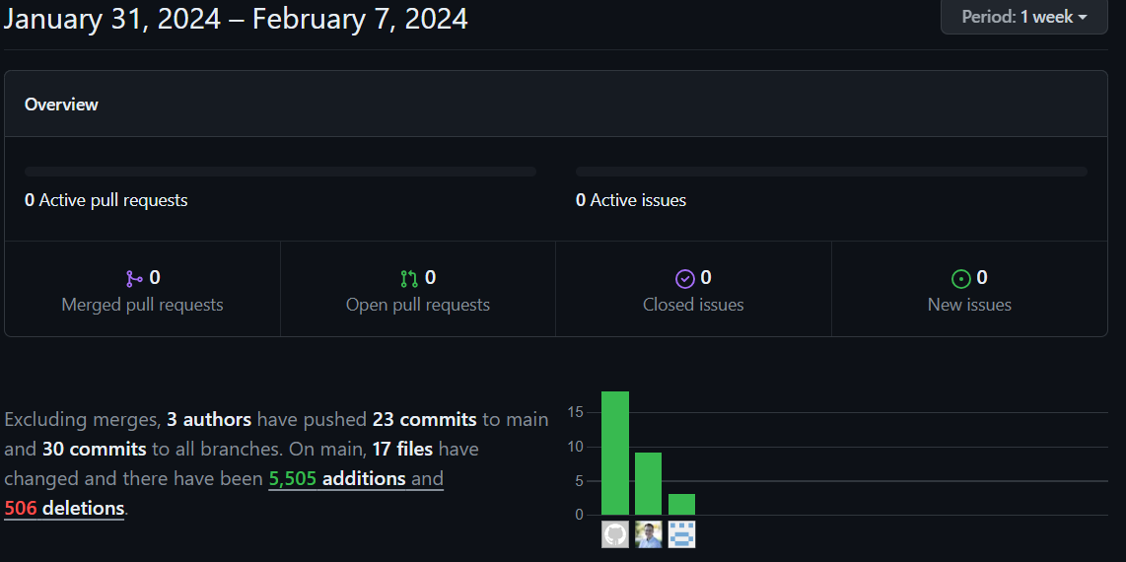
Contributions

Slide 10
DEMO
"Do not go gentle into that good night; Old age should burn and rave at close of day. Rage, rage against the dying of the light."

